Slide 1
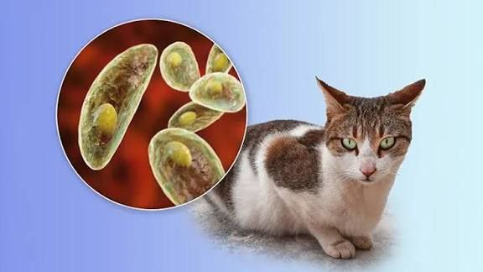
Toxoplasma gondii misconceptions and antioxidant
Asst.lec. Ghufran Salman Asst. lec. Omar Yassir

Slide 2
Toxoplasmosis is a parasitic disease caused by Toxoplasma gondii, an obligate intracellular protozoan with worldwide distribution.
Humans usually acquire the infection through consumption of undercooked meat or exposure to oocysts shed in cat feces and contaminated soil.
In immunocompetent individuals, the infection is often asymptomatic or mild.
It can cause serious complications in pregnant women, fetuses, and immunocompromised patients.
The parasite is notable for its ability to establish long-term latent infection within body tissues.

Slide 3
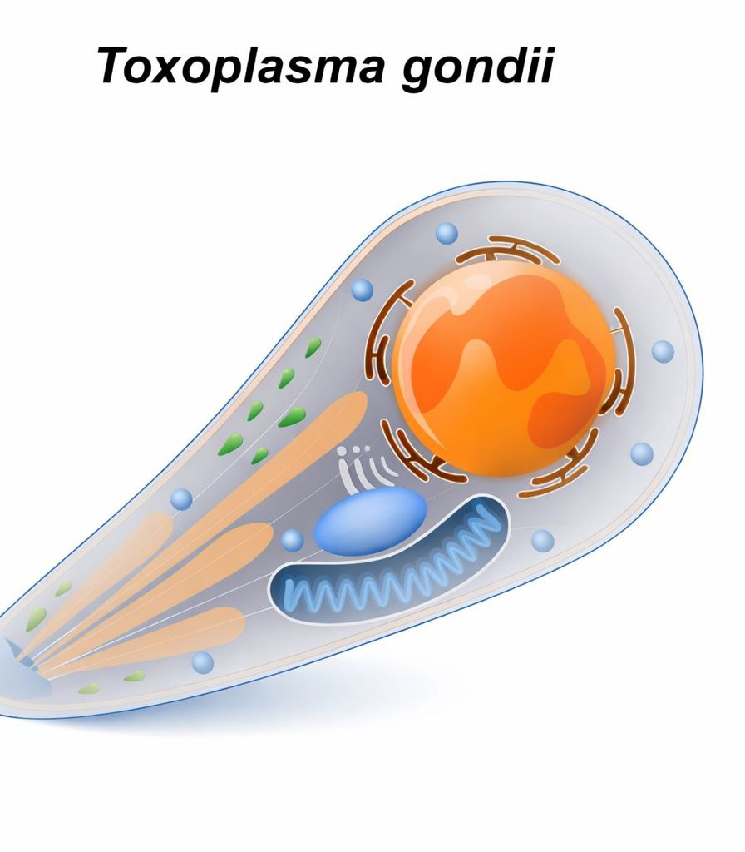
A single-celled intracellular parasite.
Causes the disease Toxoplasmosis.
Infects humans and warm-blooded animals.
Cats are the definitive hosts; humans and other animals are intermediate hosts.

Slide 4
Morphology
Toxoplasma gondii has three main developmental stages, each with a distinct mode of formation and location
Tachyzoite: The rapidly multiplying form responsible for acute infection, spreading through blood and lymph to invade various tissues such as the brain, muscles, and eyes. It causes active disease and clinical symptoms.
Bradyzoite: The slow-growing latent form that develops under immune control and persists within tissue cysts. It is mainly found in the brain, skeletal and cardiac muscles, and retina, causing chronic infection.
Oocyst: The environmental stage produced only in the intestines of cats after sexual reproduction. It is shed in feces and becomes infectious after sporulation, contaminating soil, water, and food

Slide 5
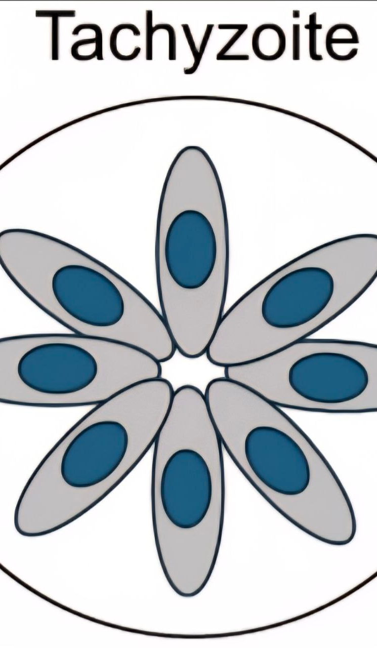
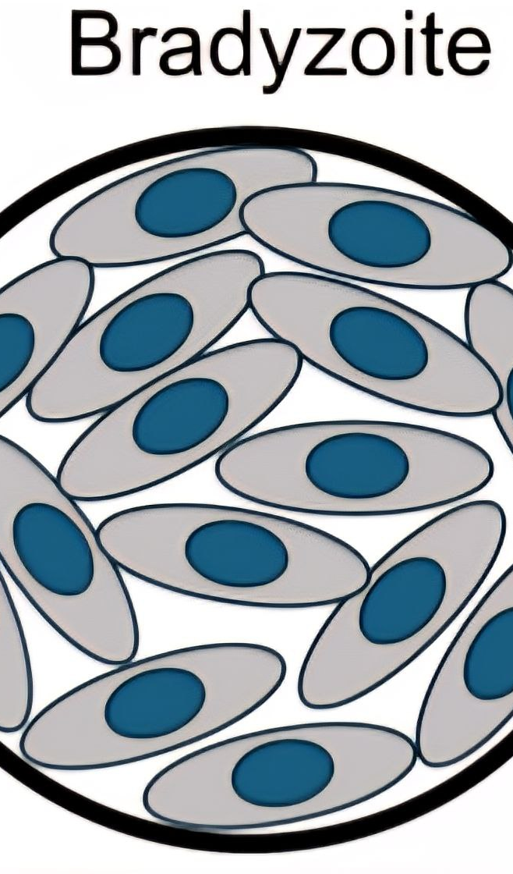
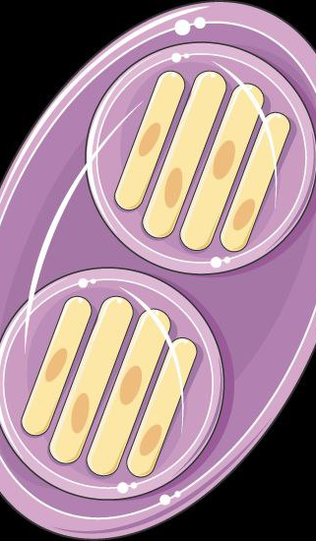

Slide 6
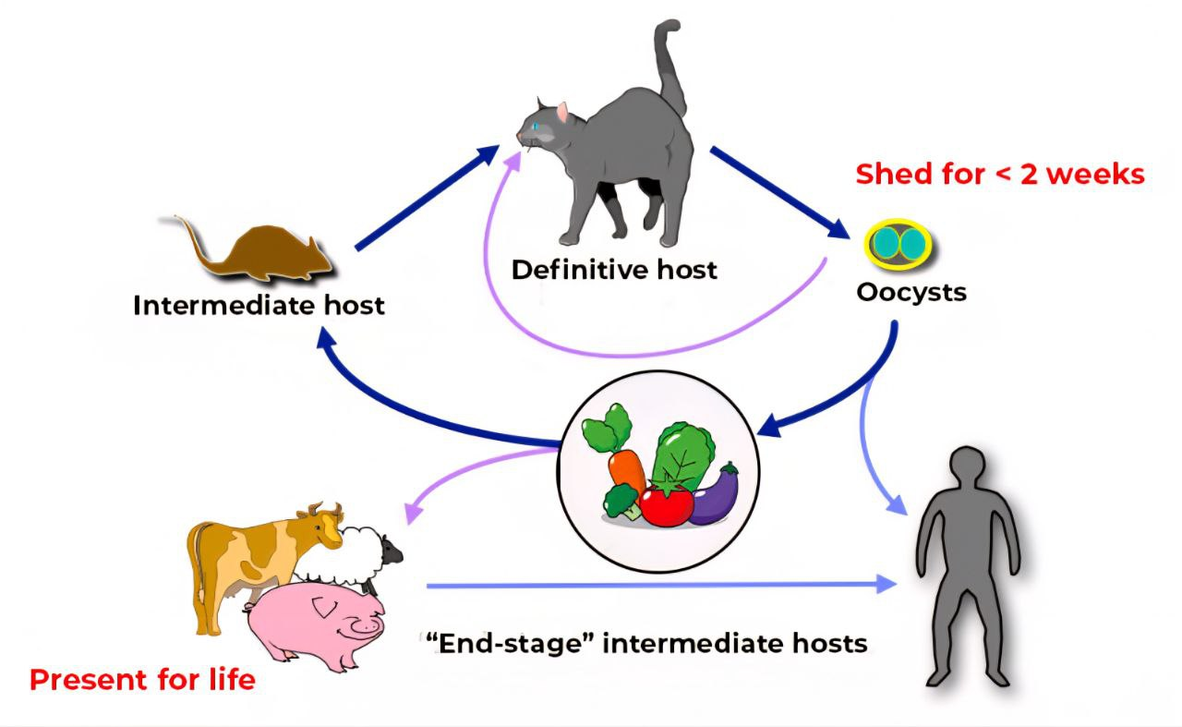
Life Cycle
Cat (definitive host) eats infected birds or rodents containing tissue cysts (bradyzoites).
Parasites are released in the cat’s intestine, undergo sexual reproduction, and produce oocysts that are shed in feces.
Environment: Oocysts sporulate within 1–5 days, becoming infectious and contaminating soil, water, and food.
Birds or rodents (intermediate hosts): Ingest oocysts; parasites develop as tachyzoites that spread in tissues, then form bradyzoite tissue cysts in muscles and brain.
Cat preys on infected birds or rodents, ingesting bradyzoites, and sexual reproduction resumes in the intestine, completing the cycle.

Slide 7
Routes of Transmission

Slide 8
T. gondii can be transmitted to humans and animals through several well-defined routes:
Ingestion of oocysts
From food, water, soil, or hands contaminated with cat feces.
Unwashed vegetables or fruits.
Gardening or cleaning litter boxes without proper hygiene.
Ingestion of tissue cysts (bradyzoites)
Eating raw or undercooked meat, especially pork, lamb, and goat.
Meat containing viable tissue cysts.
Congenital (vertical) transmission
From an acutely infected mother to the fetus via the placenta during pregnancy.
Can lead to congenital toxoplasmosis.
Blood transfusion or organ transplantation
Rare, but possible if the donor has an active infection.
Laboratory accidents
Accidental inoculation or ingestion in laboratory settings (very rare).

Slide 9
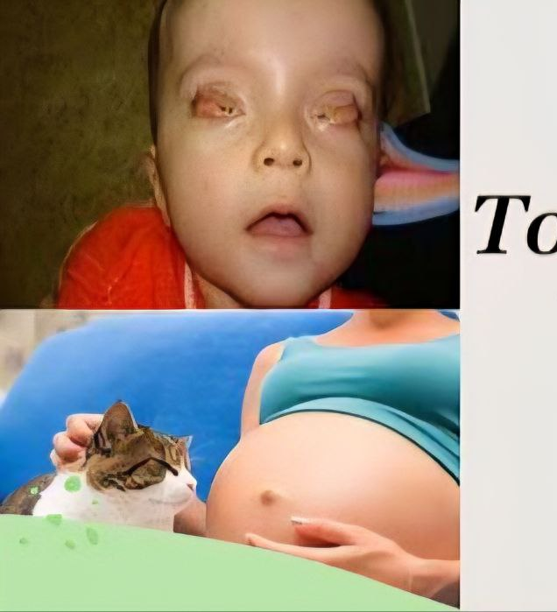

Pathogenic of Toxoplasma

Slide 10
In immunocompetent humans:
infection with Toxoplasma gondii occurs through ingestion of sporulated oocysts from contaminated food, water, or soil, or tissue cysts (bradyzoites) in undercooked meat. After ingestion, the parasites are released in the intestine and differentiate into tachyzoites, which invade host cells and disseminate via the bloodstream to various tissues.
The host immune response is predominantly cell-mediated, with macrophages and dendritic cells producing interleukin-12 (IL-12) that activates NK cells and CD4⁺/CD8⁺ T lymphocytes. These cells secrete interferon-gamma (IFN-γ), which inhibits tachyzoite replication and drives their conversion into bradyzoites. Consequently, the parasite persists as latent tissue cysts mainly in the brain, muscles, and eyes, remaining dormant and asymptomatic for life in immunocompetent individuals

Slide 11
In pregnant women
primary infection during pregnancy is of particular concern due to the risk of transplacental transmission. The severity of fetal effects depends on the trimester of infection:
First trimester: Highest risk of severe outcomes, including miscarriage, intrauterine fetal death, or major congenital abnormalities, especially involving the brain and eyes.
Second trimester: May lead to neurological and ocular complications such as hydrocephalus, intracranial calcifications, and chorioretinitis.
Third trimester: Infection is usually milder at birth, and infants may be asymptomatic initially, though late-onset visual or neurodevelopmental problems can occur later in life.

Slide 12
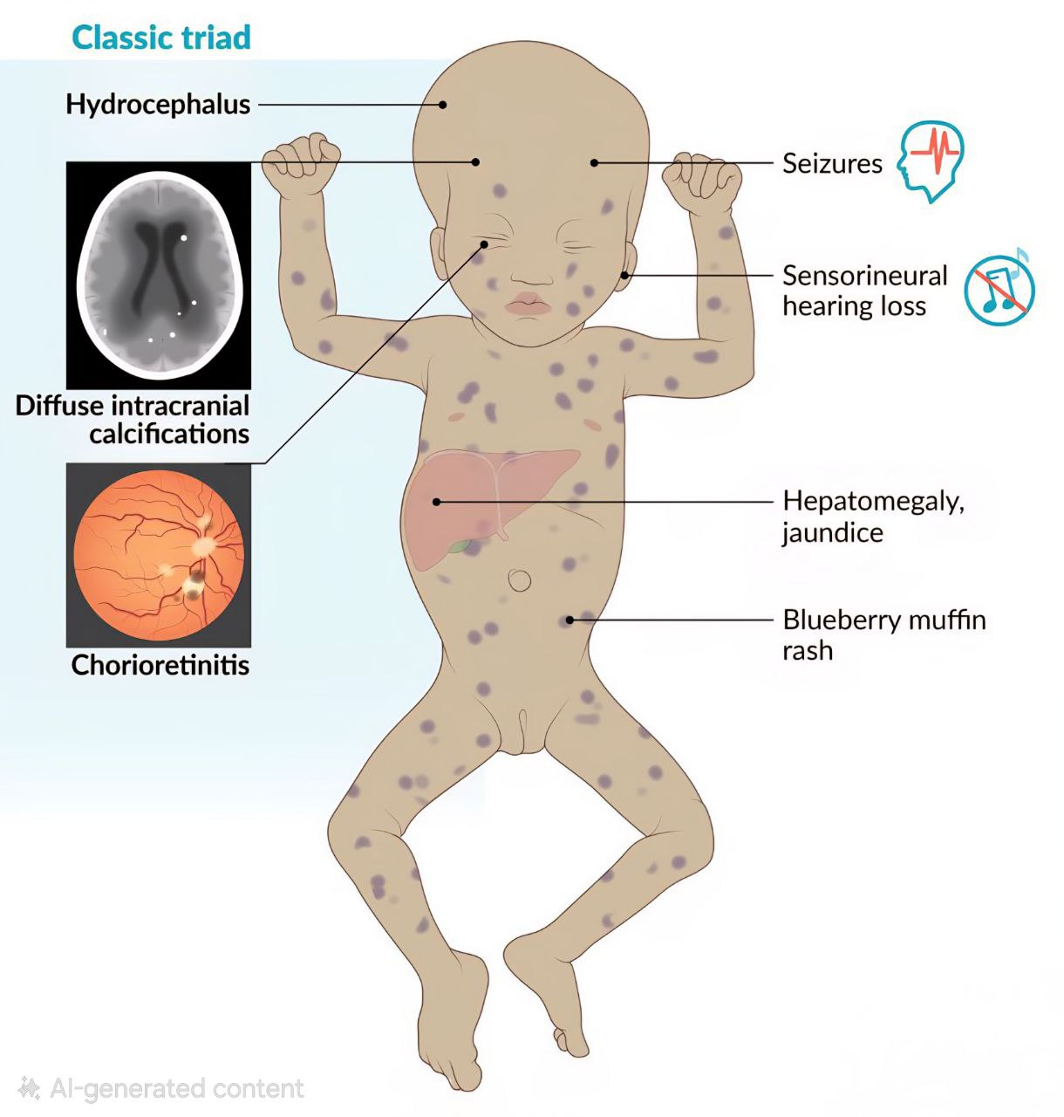
Congenital toxoplasmosis
occurs when a pregnant woman acquires a primary infection with Toxoplasma gondii during pregnancy and the parasite crosses the placenta to infect the fetus. The risk of transmission increases with gestational age, while the severity of fetal damage is greater when infection occurs early in pregnancy. Clinical manifestations include the classic triad of chorioretinitis, hydrocephalus, and intracranial calcifications, along with possible miscarriage or stillbirth in severe cases. Some infected infants may appear asymptomatic at birth but can develop visual, neurological, or developmental impairments later in life.

Slide 13
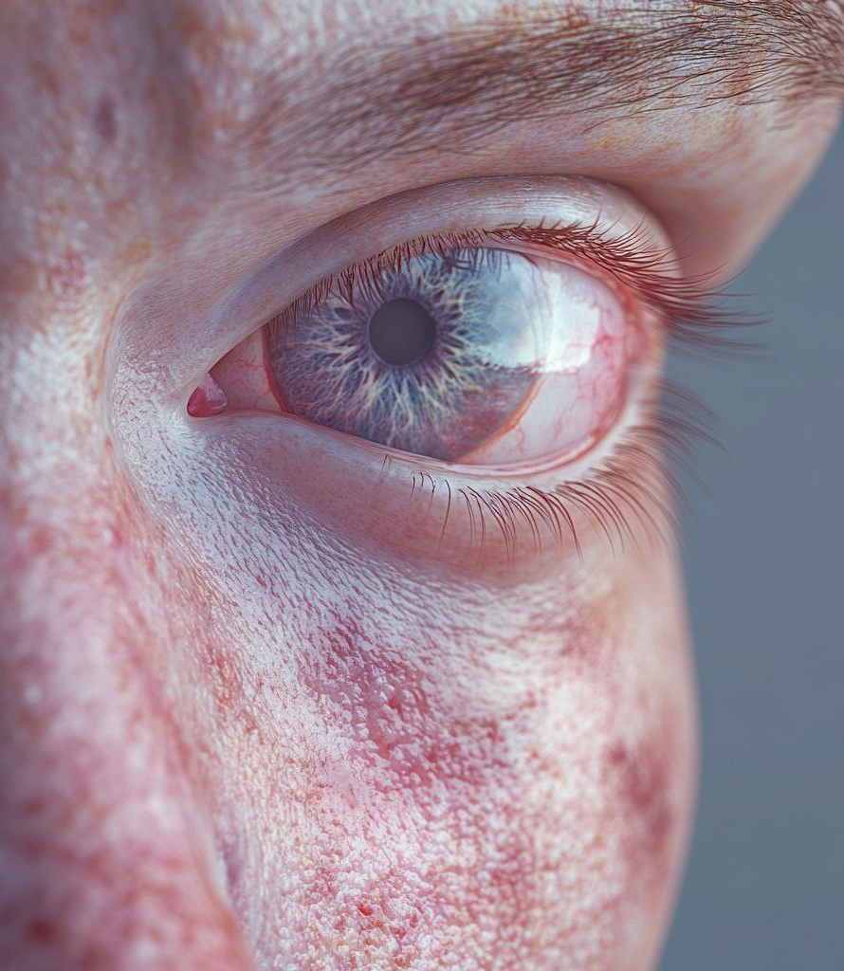
In immunocompromised individuals
such as patients with HIV/AIDS, cancer, or organ transplant recipients, toxoplasmosis may result from reactivation of latent infection and cause severe, life-threatening complications. The most common manifestation is toxoplasmic encephalitis, presenting with headache, seizures, altered mental status, or coma. Other possible complications include pneumonitis, myocarditis, and chorioretinitis, and prompt treatment is essential.

Slide 14
How to Reduce the risk of Toxoplasmosis

Slide 15


Slide 16
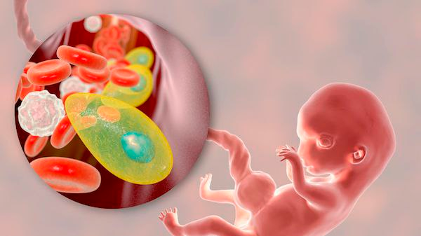
Diagnosis of Toxoplasmosis

Slide 17
Serology
mainly diagnosed by serological tests detecting anti-Toxoplasma IgM and IgG antibodies.
PCR
used in congenital and immunocompromised cases to detect parasite DNA.
CT scan, MRI
used to support the diagnosis, especially in cases of toxoplasmic encephalitis

Slide 18
Misconceptions

Slide 19
General
❌ Toxoplasmosis is a rare disease.
✔️ The parasite is widespread worldwide, and many infections are asymptomatic.
❌ Infection occurs only through cats.
✔️ The most common sources are undercooked meat and contaminated vegetables or water.
❌ Every toxoplasmosis infection is dangerous.
✔️ In healthy individuals, infection is usually mild or unnoticed.
❌ Toxoplasmosis affects only pregnant women.
✔️ Anyone can be infected, but primary infection during pregnancy carries the highest risk.
❌ Toxoplasmosis spreads easily from person to person.
✔️ Person-to-person transmission is rare and occurs only in special cases such as congenital infection or blood transfusion.
misconceptions

Slide 20
II. Specific ( Cat Owners)
❌ Cats must be removed from the home during pregnancy.
✔️ Cats can be safely kept with simple precautions.
❌ Toxoplasma is transmitted by touching cats.
✔️ The parasite is not transmitted through cat fur or casual contact.
❌ Cats shed the parasite throughout their lives.
✔️ Shedding usually occurs only once for a short period after initial infection.
❌ All cats pose a high risk of infection.
✔️ Indoor cats fed commercial or cooked food pose very low risk.
❌ Cleaning the litter box always causes infection.
✔️ The risk is minimal when the litter box is cleaned daily, gloves are used, and hands are washed properly.

Slide 21
Antioxidants

Slide 22
Antioxidants are substances that protect body cells from damage caused by free radicals, which are unstable molecules produced during normal metabolism or due to external factors such as pollution, smoking, and radiation.
Excess free radicals lead to oxidative stress, a condition associated with many chronic diseases including cardiovascular diseases, cancer, diabetes, and neurodegenerative disorders.
Antioxidants neutralize free radicals and prevent damage to essential cellular components such as lipids, proteins, and DNA.
They include vitamins (such as vitamin C and E), minerals (like selenium and zinc), and plant-derived compounds such as flavonoids and polyphenols, commonly found in fruits, vegetables, coffee, tea, and nuts.
Due to their anti-inflammatory and immune-supporting effects, antioxidants play an important role in disease prevention, healthy aging, and overall health maintenance.

Slide 23
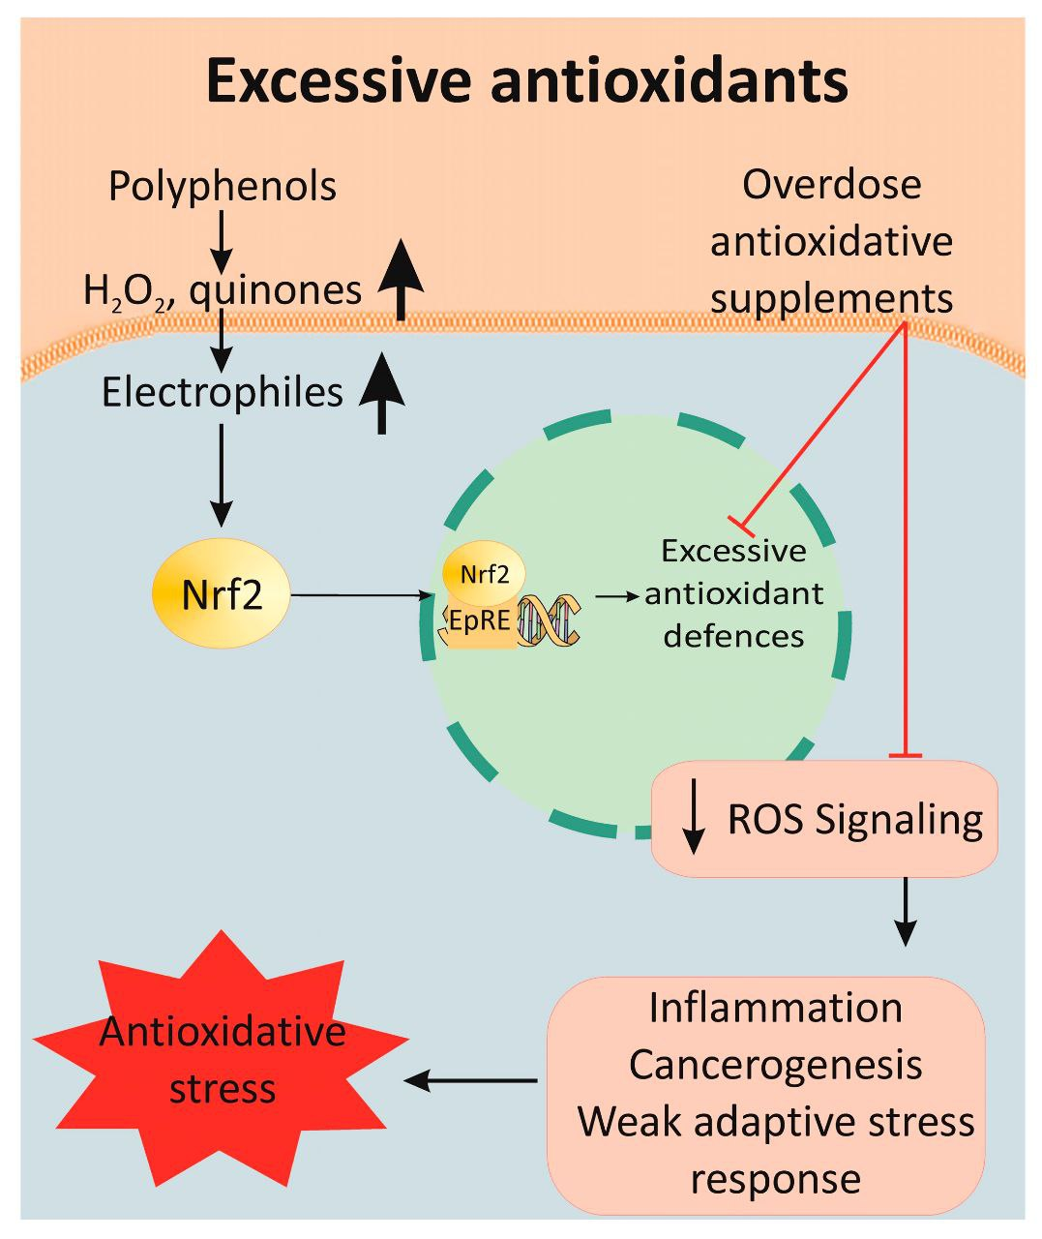

Slide 24
Oxidative Stress in Toxoplasmosis
ROS and RNS Production by Host Cells
When T. gondii invades host cells, innate immunity—especially macrophages and neutrophils—responds with Reactive Oxygen Species (ROS), Superoxide anion (O₂•⁻), Hydrogen peroxide (H₂O₂), Hydroxyl radicals (•OH), Reactive Nitrogen Species (RNS),Nitric oxide (NO) via inducible nitric oxide synthase (iNOS), Peroxynitrite (ONOO⁻), a potent cytotoxic molecule formed from NO + O₂•⁻
These species are essential for:
Inhibiting parasite proliferation
Inducing parasite death or slowing replication
Activating downstream immune pathways
B. Cytokine Interface
IFN-γ is the most important cytokine in toxoplasmosis.
It enhances ROS/RNS production and activates macrophages.
TNF-α and IL-12 also amplify oxidative stress.

Slide 25
2. Parasite Antioxidant System: Survival Machinery
T. gondii must deal with oxidative pressure inside macrophages and parasitophorous vacuoles, key antioxidant enzymes expressed by the parasite:
A. Enzymatic Antioxidants
1. Superoxide dismutase (SOD1, SOD2, SOD3): Convert superoxide → H₂O₂.
2. Catalase: Breaks down H₂O₂ → water and oxygen.
T. gondii catalase is unique—it is cytosolic and essential for tachyzoite survival.
3. Glutathione System: Glutathione peroxidase (TgGPx)
Glutathione reductase (TgGR): Parasite maintains high GSH/GSSG ratio to detoxify peroxides.
4. Peroxiredoxins and Thioredoxins: Detoxify lipid hydroperoxides, Protect membrane integrity
Important in chronic infection.

Slide 26
B. Non-enzymatic Antioxidants in Parasite
Low molecular weight thiols
Vitamin E–like compounds (detected in cyst wall elements)
C. Why is this important?
These systems allow Toxoplasma to:
Survive inside activated macrophages
Resist IFN-γ–mediated killing
Persist in tissues as cysts

Slide 27
3. Host Antioxidants During Infection
A. Oxidative Imbalance
Glutathione (GSH) decreases in liver, brain, spleen
MDA (malondialdehyde)—a marker of lipid peroxidation—increases
SOD and catalase activity reduce in acute infection
*This indicates high oxidative burden.
B. Physiological Role of Antioxidants
Host antioxidants:
Prevent damage to cell membranes, mitochondria, DNA
Limit inflammation-induced tissue injury
Protect organs such as: Retina, CNS and Liver

Slide 28
4. Effects of External Antioxidants on Toxoplasmosis
A. Antioxidants That Show Benefit in Studies
Curcumin
Reduces oxidative stress markers (↓MDA, ↑GSH)
Downregulates inflammatory cytokines
In some studies, inhibits tachyzoite replication
Possible interference with parasite cytoskeleton and calcium signaling
2. Resveratrol
Strong antioxidant and anti-inflammatory
Reduces parasite load in animal models
Enhances apoptotic pathways in infected cells
Inhibits parasite replication via SIRT1 activation and mitochondrial effects

Slide 29
3. Vitamin E + Vitamin C
Decrease tissue oxidative damage
Improve neurological and ocular outcomes
4. N-acetylcysteine (NAC)
Raises intracellular GSH
Protects hepatocytes and neurons
May reduce inflammation in chronic toxoplasmosis
5. Selenium
Cofactor for glutathione peroxidase
Deficiency worsens infection severity
Supplementation reduces oxidative stress

Slide 30
B. Antioxidants with Antiparasitic Potential
Some compounds have dual effects (antioxidant + direct anti-Toxoplasma action):
Melatonin, Quercetin, Kaempferol and Alpha-lipoic acid
Mechanisms include:
Mitochondrial dysfunction in parasite
DNA/RNA damage protection for host
Modulation of inflammatory pathways (NF-κB, Nrf2)

Slide 31
5. Risks of High Antioxidant Use
Antioxidants protect tissues, extremely high doses may reduce beneficial ROS that the immune system uses to kill T. gondii.
Possible consequences:
Reduced macrophage activity
Lowered NO levels
Potentially higher parasite survival
Blunted IFN-γ effects
*Thus, antioxidants must be viewed as: Supportive therapy, not curative.

Slide 32
6. Therapeutic Implications
A. Adjunct Therapy
Used with standard therapy (pyrimethamine + sulfadiazine):
Reduce oxidative side effects
Protect liver/bone marrow
Reduce drug-induced toxicity
B. Chronic Toxoplasmosis
In chronic cyst stage:
Inflammation and ROS damage surrounding neurons
Antioxidants help reduce neuroinflammation
This may benefit patients with ocular or cerebral toxoplasmosis

Slide 33
7. Summary
T. gondii induces strong oxidative stress
Host and parasite both depend on antioxidant systems
External antioxidants protect host tissues
Some antioxidants show anti-parasitic effects
Over-supplementation could theoretically impair immune killing
Most useful as adjunct therapy, not primary treatment

Slide 34

Thank you

