Slide 1
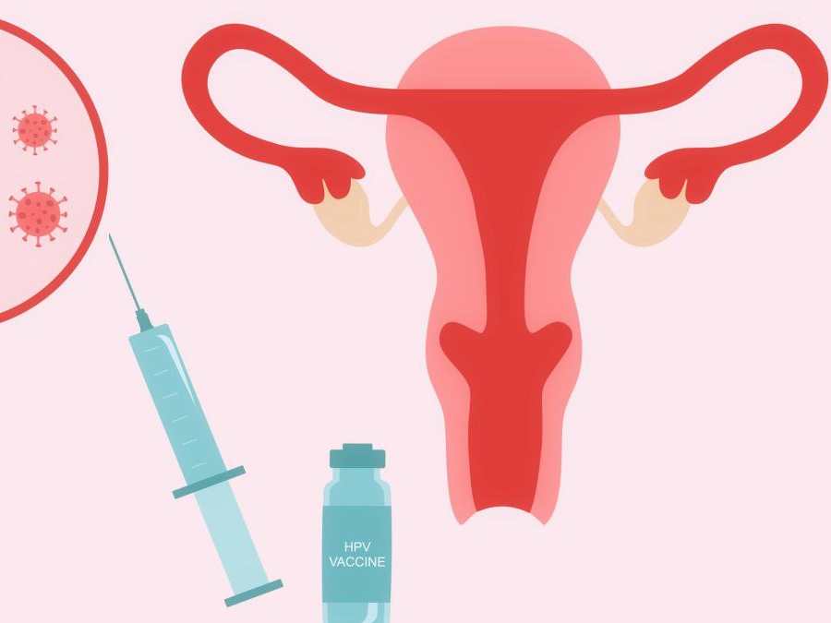
Cervical Cancer
What Every Woman Needs to Know
Assit.Lec. Lujain A. Ghannawi Assit.Lec. Ghufran S. Jawad

Slide 2
بسْمِ اللَّهِ الرَّحْمَنِ الرَّحِيمِ
﴿وَاللَّهُ يَعْلَمُ مَا تَحْمِلُ كُلُّ أُنثَىٰ وَمَا تَغِيضُ الْأَرْحَامُ وَمَا تَزْدَادُ وَكُلُّ شَيْءٍ عِندَهُ بِمِقْدَارٍ﴾
الرعد: 8

Slide 3
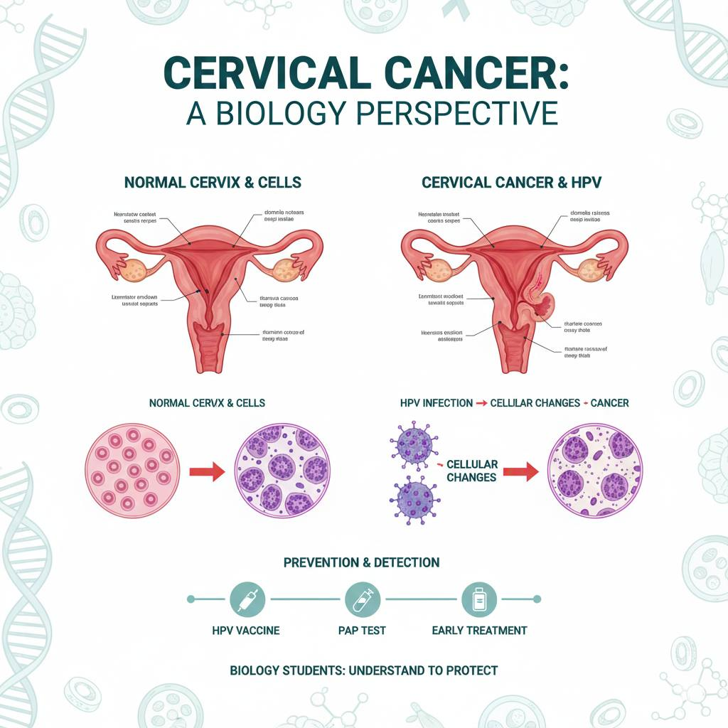

Slide 4
Why Are We Talking About Cervical Cancer?
Cervical cancer is one of the most preventable and treatable cancers when detected early.
It remains a major health problem for women, especially in communities where awareness and regular screening are limited.
The danger of this disease lies not in its aggressiveness, but in its silent progression, as it often develops over many years without noticeable symptoms.

Slide 5
The Hidden Risk
Many women believe that gynecological examinations are only necessary when symptoms such as pain or bleeding appear.
Cervical cancer may progress quietly without any warning signs until it reaches an advanced stage.
This is why relying on symptoms alone can lead to delayed diagnosis and poorer outcomes.

Slide 6
Common Misconceptions
There are several misconceptions surrounding cervical cancer, including the belief that it affects only certain women or is related to poor hygiene.
The primary cause is infection with Human Papillomavirus (HPV), a very common virus that most people are exposed to at some point in their lives, often without knowing it.
Understanding this helps reduce stigma and encourages women to seek screening without fear or embarrassment.

Slide 7
Prevention Gives Hope
The good news is that cervical cancer is largely preventable.
Regular screening can detect pre-cancerous changes long before cancer develops, allowing for simple and effective treatment.
Vaccination against HPV and routine screening together can dramatically reduce both incidence and mortality.

Slide 8
Objectives
• Understanding the etiology of Cervical Cancer.
• Identifying the primary risk factors and the role of HPV.
• Discussing the intersection of metabolic health (Diabetes) and oncology.
• Emphasizing the clinical importance of early screening (Pap Smears & HPV Testing).

Slide 9
What is Cervical Cancer?
• A malignant tumor of the cervix, the lowermost part of the uterus.

Slide 10
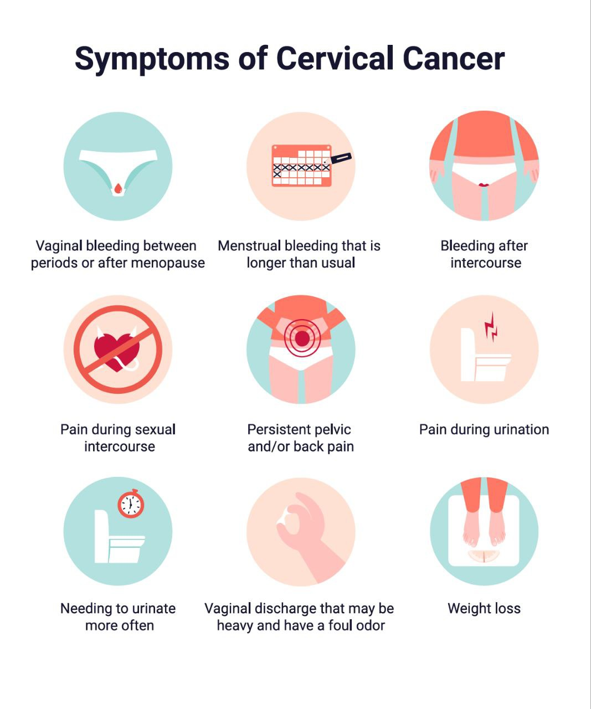

Slide 11
Global Burden: Cervical cancer is the fourth most common cancer among women worldwide, with an estimated 600,000+ new cases annually.
Mortality: It remains a leading cause of cancer-related death in low- and middle-income countries due to a lack of organized screening programs.
The "Preventable" Paradox: Despite being one of the most preventable forms of malignancy, late-stage diagnosis remains high in regions with limited health awareness.

Slide 12
The Necessary Cause (HPV)
Human Papillomavirus (HPV): A group of more than 200 related viruses.
High-Risk Genotypes: Types 16 and 18 are "high-risk" oncogenic strains responsible for approximately 70% of all cervical carcinomas.
Viral Persistence: While most HPV infections clear spontaneously within 2 years, persistent infection with high-risk types is the primary driver of cellular transformation.
Transmission: Primarily through skin-to-skin contact; the virus targets the basal layer of the cervical epithelium.

Slide 13
The Intersection of Diabetes and Oncology
Metabolic issues: Chronic Hyperglycemia is associated with an increased risk of several cancers.
Immune Dysfunction in Diabetes: T-cell mediated immunity is often compromised in diabetic patients, potentially hindering the body's ability to clear persistent HPV infections.
•IGF-1 Axis: High insulin levels (Hyperinsulinemia) can activate Insulin-like Growth Factor-1 (IGF-1) receptors, which act as mitogens, stimulating tumor cell growth and survival.
Clinical Takeaway: Diabetic patients require more rigorous adherence to screening protocols due to their altered immune landscape.

Slide 14
Risk Factors & Co-Factors
Primary Factor: Persistent high-risk HPV infection.
Synergistic Factors:
Tobacco Use: Byproducts of cigarette smoke damage the DNA of cervix cells and weaken the localized immune response.
Immunosuppression: HIV infection or immunosuppressive therapy.
Parity: High number of full-term pregnancies.
Long-term Oral Contraceptive Use: Research suggests a slight increase in risk with use over 5 years.

Slide 15
Clinical Progression: CIN to Invasive Cancer
Cervical Intraepithelial Neoplasia (CIN): Pre-cancerous changes categorized by severity:
CIN 1: Mild dysplasia (often regresses).
CIN 2: Moderate dysplasia.
CIN 3: Severe dysplasia/Carcinoma in situ (high risk of progression).
Timeline: The progression from CIN 3 to invasive cancer typically takes 10 to 20 years, providing a wide "window of opportunity" for medical intervention.

Slide 16
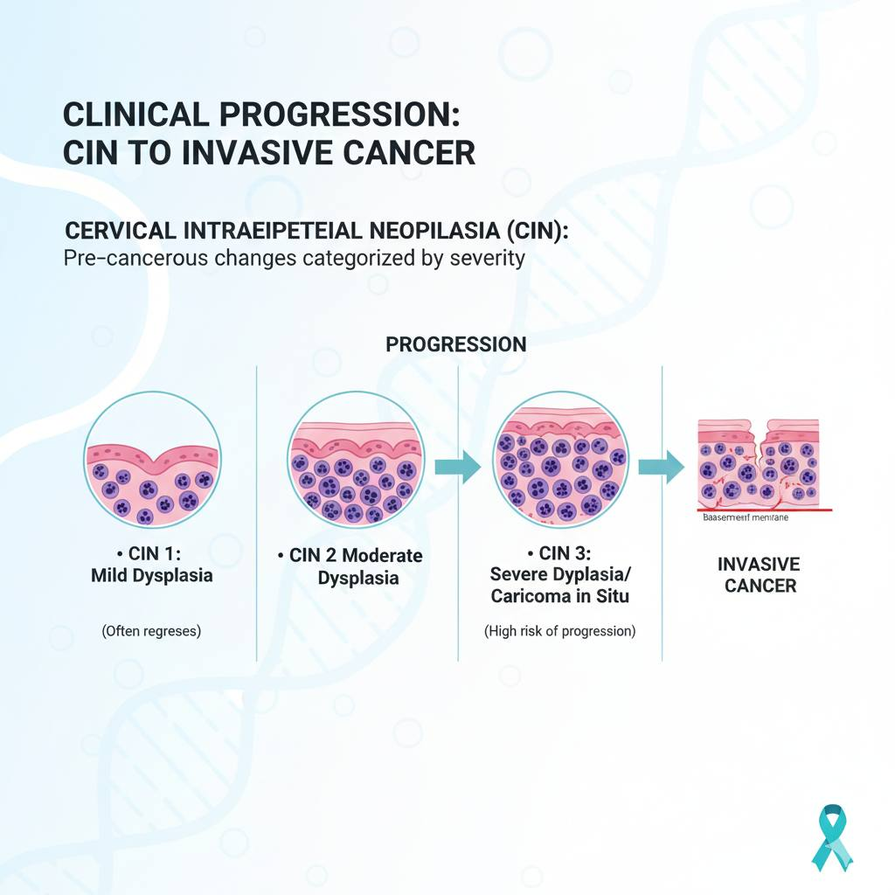

Slide 17
Diagnostic
Gold Standards
(Screening)
The Pap Test (Cytology): Identifying abnormal morphology in exfoliated cervical cells.
HPV DNA Testing (Molecular): High-sensitivity testing to detect the presence of viral genetic material before cellular changes occur.
Co-Testing: The gold standard for women over 30, combining both Cytology and HPV DNA testing to maximize negative predictive value.
Visual Inspection (VIA): Used in low-resource settings as a "see-and-treat" approach.

Slide 18

Primary Prevention: the HPV vaccine
Vaccine Composition: Non-infectious Virus-Like Particles (VLPs).
Efficacy: Vaccines like Gardasil 9 protect against 9 strains (6, 11, 16, 18, 31, 33, 45, 52, 58).
Timing: Most effective when administered between ages 9–14, before any exposure to the virus.
Public Health Impact: Countries with high vaccination coverage have seen a nearly 90% reduction in cervical cancer and pre-cancerous lesions.

Slide 19
Professional and Institutional Responsibility
• Empowerment through Education: As university graduates at a Diabetes Center, you are trusted voices in healthcare.
• Integrating Care: Every female patient visiting for diabetes management should be screened for their last Pap smear date.
• Breaking Stigma: Reducing the social stigma associated with HPV and gynecological examinations is essential for increasing screening uptake.

Slide 20
Conclusions
Key Message: Cervical cancer is preventable, detectable, and curable.
The Goal: Eliminate cervical cancer as a public health problem through the 90-70-90 strategy:
90% of girls vaccinated by age 15.
70% of women screened by age 35 and 45.
90% of women with cervical disease receiving treatment.

Slide 21

THANK YOU

