Slide 1
of Microorganism The Growth
م.م. صفية سعد ضيف
م.م. زينب عمر يوسف

Slide 2
Definition of Growth
Growth means an increase in size, number, weight, and mass. It involves reactions leading to macromolecule synthesis and cell division.

Slide 3
Cell Cycle Overview
The cell cycle includes successive events depending on environmental conditions. Generation time is the time from the beginning to the end of division, and growth rate is the resulting increase.

Slide 4
Generation Time (Doubling Time(
Generation time is the time for a single cell to undergo fission.
In prokaryotes (e.g., E. coli): 20–25 minutes.
In eukaryotes: from 2 hours to several days.
Generation time varies with:
Species of M.O.
Nutrients.
Environmental conditions: PH, and temperature.
Growth phase.

Slide 5
Prokaryotic Cell Cycle
Most studies are done on E. coli due to ease of handling.
It includes several stages influenced by environmental factors.

Slide 6
      First stage G1:
      This period is still under speculating. Mostly, under the optimal condition it disappears due to the shortage of generation time, also the environmental conditions greatly affect the cell.

Slide 7
      Second stage S:
    A stage of DNA synthesis abbreviated as C instead of S, it means chromosome replication.
    It required most of cycle time.
    It controls the continuity of the cycle, since when the DNA synthesis is interrupted the cell will not divide.
    It is affected, a little, by the environmental conditions.

Slide 8
Stage 3 & 4 (G2 and M(
After DNA synthesis, there is a gap before division.
Referred to as D phase.
Slightly affected by environmental conditions.

Slide 9
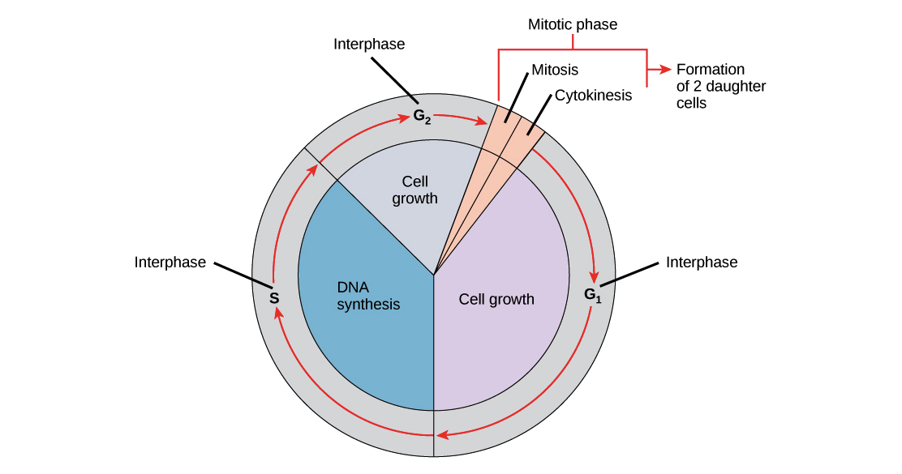

Slide 10
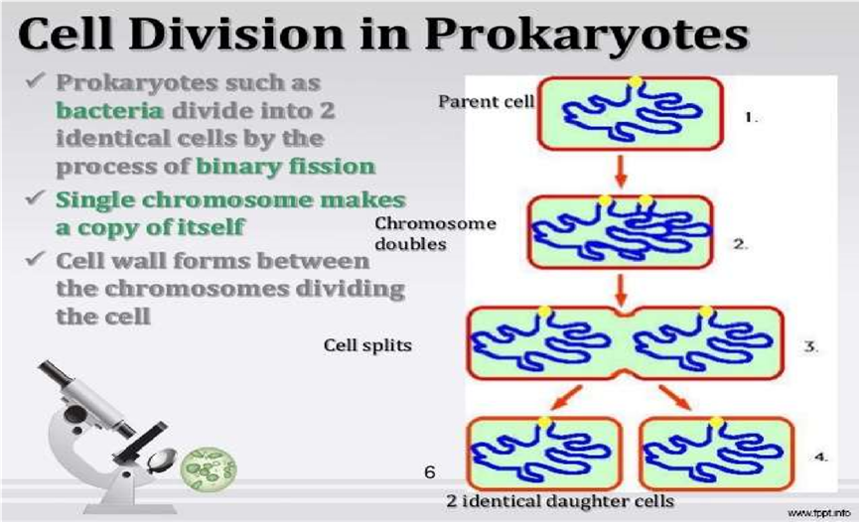

Slide 11
Bacterial Growth Curve
When bacteria are inoculated into a new medium, they follow a characteristic growth pattern with several phases.

Slide 12
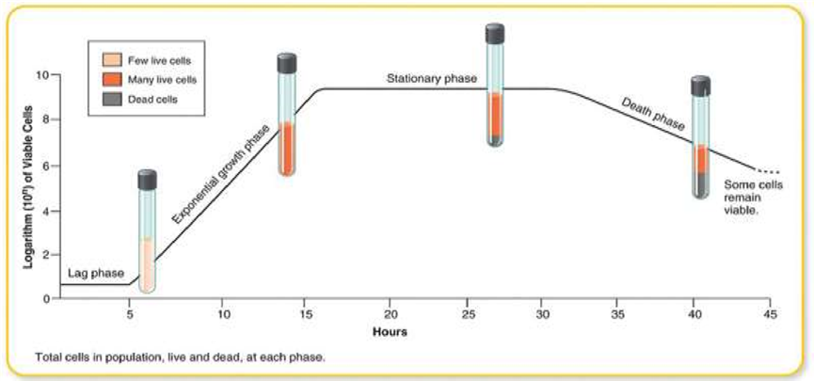

Slide 13
Lag Phase
Cells adjust to new medium, increase in size but not in number.
Preparation for DNA and enzyme synthesis.

Slide 14
Log (Exponential) Phase
Cells divide at a constant rate.
Growth rate is maximal and uniform.

Slide 15
Stationary Phase
Growth rate equals death rate.
Nutrients deplete, waste accumulates, pH changes.
Food begins to run out, poisonous waste products accumulate, PH changes, hydrogen acceptors are used up, and energy transfers are diminished.
The rate of fission begins to decline, and the organisms die in increasing numbers.

Slide 16
Death (Decline) Phase
Viable cells decline exponentially.
Cell lysis and death occur progressively.

Slide 17
What is the importance (benefits) of microbial growth?
Microbial growth is very important in many fields:
Food Industry
  Production of yogurt, cheese, bread, vinegar
  Food fermentation and preservation
Medicine and Biotechnology
  Production of antibiotics (e.g., penicillin)
  Production of vaccines, enzymes, and hormones (like insulin)
Environmental Applications
  Decomposition of organic matter
  Wastewater treatment
  Bioremediation (cleaning polluted environments)
Scientific Research
  Studying genetics, metabolism, and disease mechanisms
Agriculture
  Nitrogen fixation by bacteria
  Improving soil fertility

Slide 18
Methods of Measuring Cell Mass
. Direct physical measurement (dry/wet weight(
. Chemical measurement (N, protein, DNA(
. Indirect measurement (O2, CO2 activity(
. Turbidity measurement (optical density(

Slide 19
Turbidity Measurement
Light scattering by cells correlates with their number.
Optical density is directly related to cell mass or count.

Slide 20
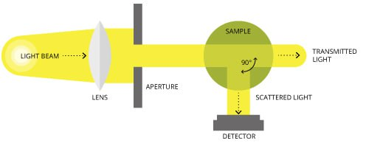

Slide 21
Measurement of Cell Numbers
Methods include direct microscopic count, electronic counting, and viable cell count (CFU(.

Slide 22
Direct Microscopic Count
Using a hemocytometer or Breed method.
Counts total cells but cannot distinguish live/dead ones.

Slide 23
Electronic Counting
Used mainly for eukaryotic cells.
Measures size distribution and count simultaneously.

Slide 24
Viable Plate Count
Sample is plated on nutrient agar.
Each viable cell forms a colony (CFU(.
Advantages: sensitivity and identification.
Disadvantages: only living cells grow, clumping may occur.

Slide 25
Determination of Cell Activity
Measures chemical changes (e.g., acid from sugar metabolism(.
Can assay specific enzymes to estimate growth.

Slide 26
Environmental Impact on Growth
Factors such as pH, temperature, and nutrients greatly influence growth rate and cell cycle duration.

Slide 27
Applications of Growth Measurement
Used in industrial microbiology, food safety, medical microbiology, and biotechnology.

Slide 28
Growth in Closed Systems
In batch cultures, growth follows typical dynamics: lag → log → stationary → death.

Slide 29
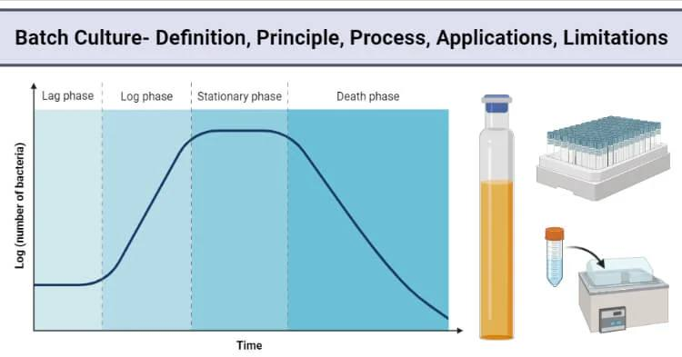

Slide 30
Continuous Culture Systems
Maintain bacteria in exponential phase using chemostats, balancing nutrient flow and waste removal.

Slide 31


